Slide 1
Image Colourization using GANs
Student name: Danush S
Register no. : 421221104007
Department: Computer Science and
Engineering

Slide 2
PROJECT TITLE
Image Colourization using GANs
Conversion of monochrome images
into colour images

Slide 3
AGENDA
Problem Statement
Project Overview
End users
Solutions and its value proposition
WOW in my solution
Modelling
Results

Slide 4
PROBLEM STATEMENT
Black and white images lack vibrancy and can be less engaging for viewers.
Manually colorizing images can be time-consuming and may not always yield accurate results.

Slide 5
PROJECT OVERVIEW
Aim: Develop an automated system using Generative Adversarial Networks (GANs) to colorize black-and-white images.
Tools: Python, deep learning libraries (such as TensorFlow or PyTorch), GAN architecture

Slide 6

WHO ARE THE END USERS?
Photographers and artists seeking to revive old black-and-white images.
Graphic designers looking to enhance the appeal of their designs.
Historical archives and museums preserving and presenting historical photographs.

Slide 7
YOUR SOLUTION AND ITS VALUE PROPOSITION
Automated colorization reduces the manual effort and time required for colorizing images.
GANs ensure realistic and accurate colorization by learning from a dataset of colored images.
Enhances the visual appeal and engagement of black and white photographs and designs.

Slide 8
THE WOW IN YOUR SOLUTION
Realistic colorization: GANs generate colors that blend seamlessly with the image's context.
Flexibility: Users can choose different color palettes or adjust color intensity.
Scalability: The system can process a large number of images efficiently.

Slide 9
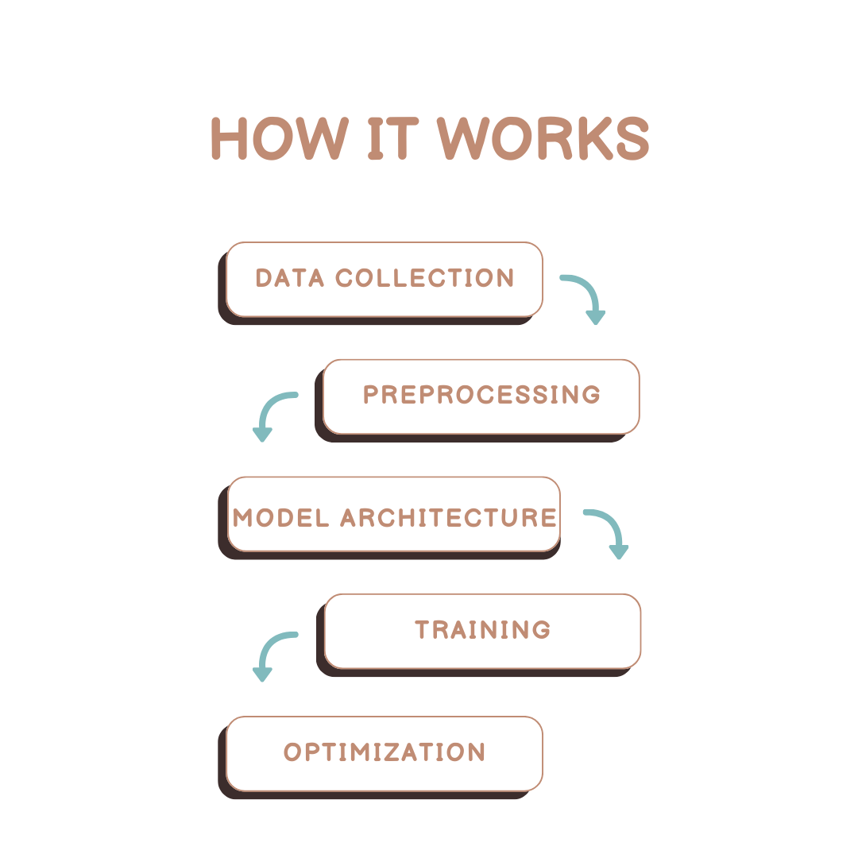
MODELLING

Slide 10
RESULTS
Quantitative Evaluation: Measure colorization accuracy using metrics such as Mean Squared Error (MSE) or Structural Similarity Index (SSIM).
Qualitative Evaluation: Showcase colorized images and compare them with ground truth colored images.
User Feedback: Gather input from end users to assess the system's usability and effectiveness.

